Slide 1
Who Governs You?
Legislative Branch

Slide 2
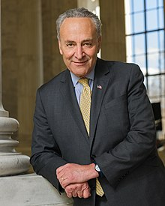
New York Senators: Chuck Schumer
Chuck Schumer
Democratic Party
Years of Service:1999-Present

Slide 3
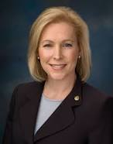
New York Senator: Kirsten Gillibrand
Kirsten Gillibrand
Democratic Party
Years of Service 2009-present

Slide 4
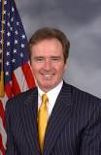
New York Congressman for 26th district: Brian Higgins
Brian Higgins
Democratic Party
26th congressional district
Years of service:2013-present

Slide 5
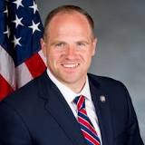
New York State Senator for Buffalo
Sen. Timothy M. Kennedy
Democratic Party
63rd district
Terms of Service 2013-present

Slide 6
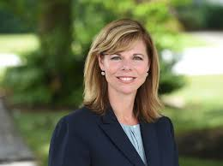
New York State Assembly Member
Monica Wallace
District 143
Democratic Party
Years of service January 1st, 2017

Slide 7
Buffalo Board of Commissioners
District 1 - Hon. Barbara Miller-Williams
District 2 - Hon. Betty Jean Grant
District 3 - Hon. Peter J. Savage, III
District 4 - Hon. Kevin R. Hardwick
District 5 - Hon. Thomas A. Loughran
District 6 - Hon. Edward A. Rath, III
District 7 - Hon. Patrick B. Burke
District 8- Hon. Ted B. Morton
District 9 - Hon. Lynne M. Dixon
District 10 - Hon. Joseph C. Lorigo
District 11 - Hon. John J. Mills

Slide 8
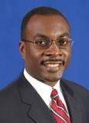
Buffalo Mayor: Byron Brown
Democratic Party
Years in office: 2005-present

Slide 9
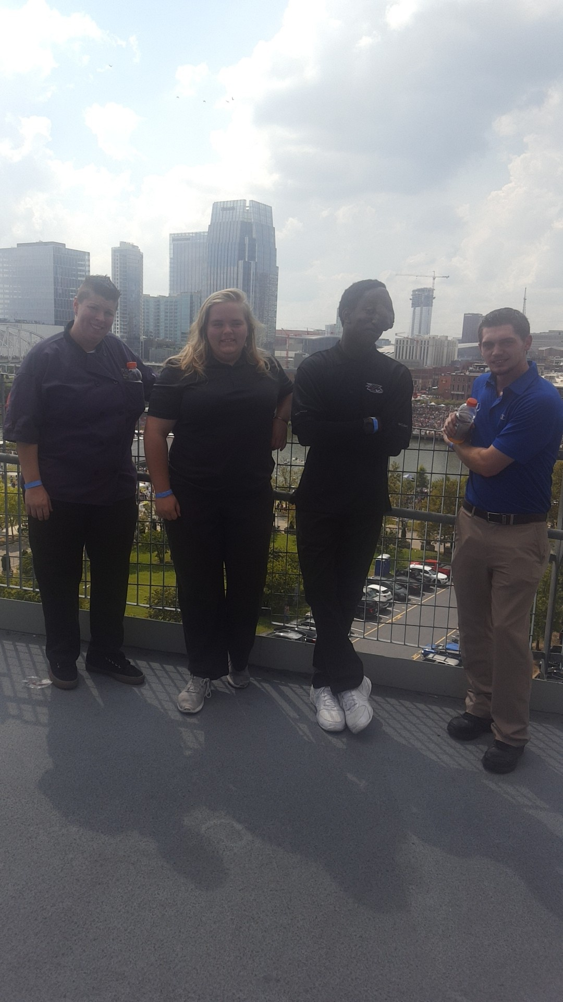
Me: Allyson Buck
Allyson Buck
Republican Party
Years of Service: 1995- Present

